Slide 1
WS 8_1
Write a function, numeric_value_ofL(Letter), which takes a single lower case or upper case letter & which returns 1 for an ‘a’ for an ‘A’, 2 for a ‘b’ or a ‘B’. …. 26 for a ‘z’ or a ‘Z’.
WS 8_2
Write a function, numeric_value_ofW(Word), which takes a Word, a combination of only lower case and upper case letters, and which uses numeric_value_of(Letter) to return the value of the word as the sum of the values of the letters in Word.
WS 8_3
Write a function numeric_value_ofS(Sentence), which takes a Sentence, which is a string consisting of words separated by spaces and where each word consists only of lowercase and uppercase letters, and which returns the sum of the numeric value of Sentence. Uses numeric_value_of(Word).

Slide 2
WS ch8_4
Write a function updown(Word), which for any string prints out what the example below shows if Word = ‘dog’:
>>> updown(‘dog’)
‘d’
‘do’
‘dog’
‘do’
‘d’
>>>
Ws ch8_5
Write a function, count_words_in(Sentence), that returns the number of words in Sentence that have between 3 and 7 letters and which contain at least 2 vowels, where vowels are taken to be the letters {‘a’,’e’,’I’,’o’,’u’}.
Ws ch8_6
Write a function, count_words_in_1(Sentence), that does the same thing as the previous function except that y is also a vowel, but only if it is at the end of the word.

Slide 3
Ws ch8_7
Write a function, num_words_in(Sentence), which returns the number of words in Sentence.
Ws ch8_7A
Write a function, RmvVwlsFrom(String), which returns the original string with the
Vowels ‘a’,’e’,’i’,’o’,’u’ removed. Write a helper function isVowel(Ltr), which returns
True if Ltr is a vowel & which otherwise returns False.
WS ch8_7B
Write a function, longestWordIn(String), which returns the length of the longest
word in String and the corresponding word(s). Uses list.index(x), which returns
The index of element x in list.

Slide 4
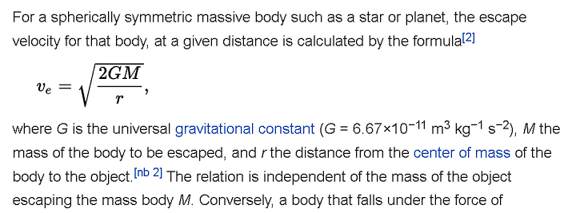
Ws ch8_8
Redo the 15 primes per line table for primes <= 1000 using the string format method. See ws ch6_9
Ws ch8_9
Print out a table for the escape velocity from the earth, where M = 5.97 x 10²⁴ kg is the mass of the earth, for r varying from 6.5 x 10⁶ m to 15x10⁶ m in increments of 0.5 x 10⁶ m . Use the formula below and print formatting with 3 significant figures for r and 3 significant figures for the escape velocity. Re = 6.37 x 10⁶ m is the radius of the earth.

Slide 5
Ws 8_10
Write a function that takes word of lowercase letters (plaintext) and which returns an enciphered word (cypher text) using a circular Caesar cypher for each letter.
The Caesar cipher is one of the earliest known and simplest ciphers. It is a type of substitution cipher in which each letter in the plaintext is 'shifted' a certain number of places down the alphabet. For example, with a shift of 1, A would be replaced by B, B would become C, and so on.
If a letter is shifted off the end of the alphabet, it goes back to the beginning of the alphabet. For example, the letter ‘y’ shifted 3 to the right becomes the letter ‘b’.
Use appropriate helper functions.

